Slide 1
First World DOWN Third World UP
Alexandro Pyka

Slide 2
Dataset:
World Development Indicators Dataset
Motivation:
It is a common hearsay that some supposedly “third world” countries are improving their standard of living to western quality levels. It is my interest for this project to investigate what indicators could set apart a declining first world country (Italy, my homeland) and a rising third world one (my beloved Brazil)
Research Question:
This analysis will be driven by the data themselves, I’m not gonna use common knowledge about economic factors but the indicators under scrutiny will be chosen by statistical inquiries

Slide 3
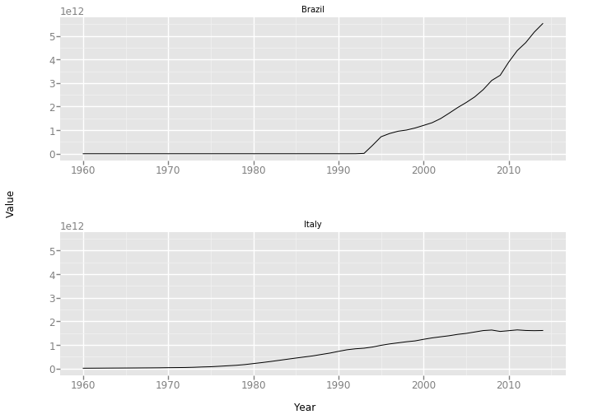
First of all we looked for which indicator changed the most throughout the years for both countries: it was the GDP and we plotted it against the years. The different trend is easy to see.

Slide 4
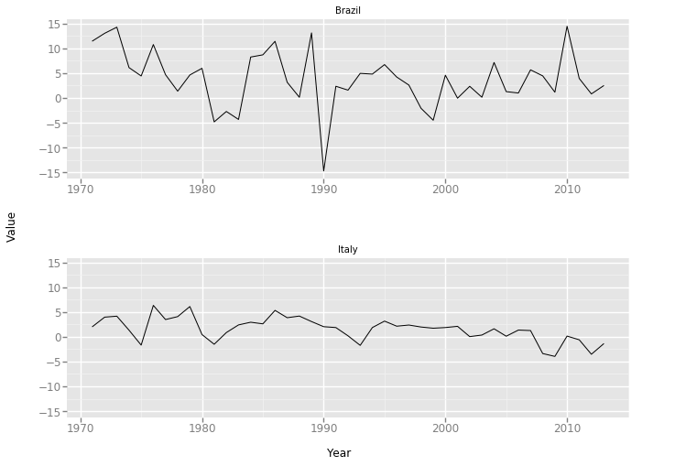
As we are concerned with change, the indicators of growth might be telling us something. We first investigated Adjusted net national income.

Slide 5
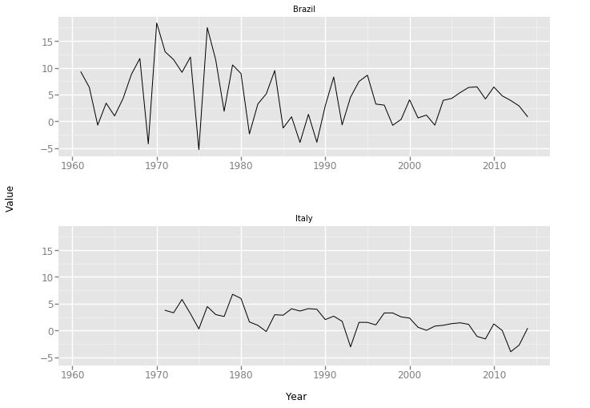
And then Household final consumption expenditure. Both confirmed our initial assumption of a declining Italian trend and a more vigorous Brazilian one.

Slide 6
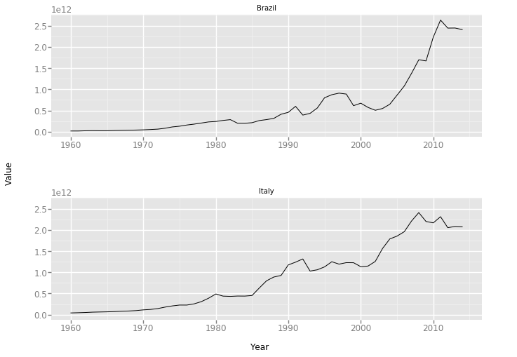
We went then to determine the strong (Gross National Expenditure) and weak (Cash surplus/deficit) points of each country, just by looking at the numbers.

Slide 7
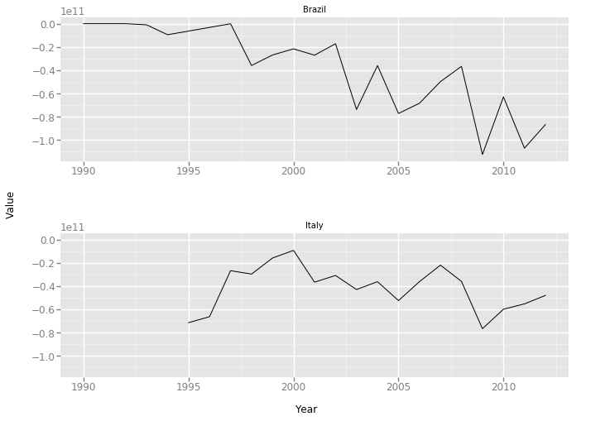
The second graph is the first that doesn’t support our initial thesis, as Brazil has both a wider range and a more decisive downward trend for the ratio between cash surplus and deficit.

Slide 8
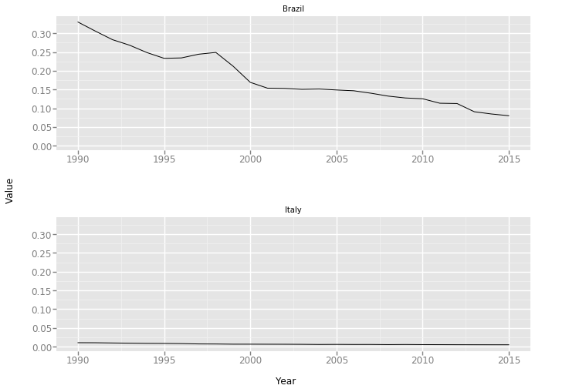
The last indicators we want to analyze are the ones where there weren’t much variation during the years. The one plotted below is the Lifetime risk of maternal death (%), where Brazil shows its gap, despite the positive trend, with Italy.

Slide 9
Conclusions:
I deem the last part of this analysis the most interesting: by comparing the indicators that had a low variation over the years, we can investigate what truly sets apart the two countries the best, as what didn’t change despite the different cycle the two countries are in.
The next step could be to compare indicators guided by general knowledge instead of just by the data. Like for example focus on indicators related to education, the health system or the environment to see if the economic growth has improved the life standard of Brazil or if the stagnation lowed Italy’s one.

